Slide 1
Sample Problems for Review

Slide 2
Input X
Input Y
X=X+Y
1. Input X
2. Input Y
3. X=X+Y
4. If Z<0 go to 7
5. X=X+1
6. Go to 8
7. X=X-1
8. Y=Y+1
9. T=X+Y
10. If Z==T go to 4
11. Output Z
4. If Z<0 go to 7
f
t
5. X=X+1
6. Go to 8
7. X=X-1
8. Y=Y+1
9. T=X+Y
10. If Z==T go to 4
f
t
11. Output Z

Slide 3
Input X
Input Y
If X<Y go to L1
Input X
Input Y
If X<Y go to L1
Z=X+Y
X=Y
Go to L2
L1: Z=X-Y
X=Y
L2: Output X
Output Y
Output Z
t
f
Z=X+Y
X=Y
Go to L2
L1: Z=X-Y
X=Y
L2: Output X
Output Y
Output Z

Slide 4
IN[1] = { }
Input X
Input Y
If X<Y go to L1
1
GEN[1] = { }
KILL[1] = {X,Y}
OUT[1] = {X,Y}
t
f
IN[3] = {X,Y}
IN[2] = {X,Y}
2
3
Z=X+Y
X=Y
Go to L2
L1: Z=X-Y
X=Y
GEN[3] = {X,Y}
KILL[3] = {X,Z}
GEN[2] = {X,Y}
KILL[2] = {X,Z}
OUT[2] = {X,Y,Z}
OUT[3] = {X,Y,Z}
IN[4] = {X,Y,Z}
L2: Output X
Output Y
Output Z
4
GEN[4] = {X,Y,Z}
KILL[4] = { }
OUT[4] = { }

Slide 5
LIVE RANGES OF X, Y and Z
Input X
Input Y
If X<Y go to L1
Input X
Input Y
If X<Y go to L1
Input X
Input Y
If X<Y go to L1
Z=X+Y
X=Y
Go to L2
Z=X+Y
X=Y
Go to L2
Z=X+Y
X=Y
Go to L2
L1: Z=X-Y
X=Y
L1: Z=X-Y
X=Y
L1: Z=X-Y
X=Y
L2: Output X
Output Y
Output Z
L2: Output X
Output Y
Output Z
L2: Output X
Output Y
Output Z

Slide 6
LIVE RANGES OF X, Y and Z
X1
Y
X2
Z

Slide 7
INTERFERENCE GRAPH
X1
Y
X1
Y
X2
Z
X2
Z

Slide 8
REGISTER ALLOCATION: R1, R2, R3
X1
REMOVE DEGREE<3
X1, X2, Z; Y
Y
COLOR IN REVERSE ORDER
Y R1
Z R2
X2 R3
X1 R2 or R3
X2
Z

Slide 9
REGISTER ALLOCATION: R1, R2
X1
REMOVE DEGREE<2
X1; spill Y; X2, Z
Y
COLOR IN REVERSE ORDER
Z R1
X2 R2
X1 R1 or R2
X2
Z

Slide 10
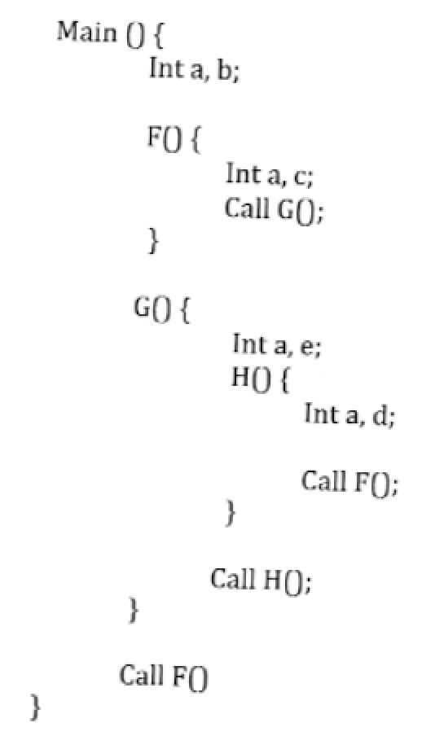
0
Main → F → G → H → F
c-d →
1-1
2-1
2-2
3-1
1
Control
Links
Access
Links
0:a
1:b
2
Main
1
0:a
1:c
F
2
G
0:a
1:e
3
0:a
1:d
H
Access
b in H
traverse
3-1=2 links
then at
offset at of 1
find b
2
0:a
1:c
1
F

Slide 11
GRAMMAR
RELEVANT PRODUCTIONS
CONSTRUCT
if x < y then
<otherstatements>
elseif a > b then
<otherstatements>
……
elseif c == d then
<otherstatements>
else
<otherstatements>
endif
<S> → if <condt> then <otherstatements> <rest>
<rest> → elseif <condt> then <otherstatements> <rest>
| else <otherstatements> endif
<condt> → id relop id
Question:
Provide SEMANTIC RULES that
generate code and finally place it
in attribute <S>.code

Slide 12
INTERMEDIATE CODE
if x < y go to L1
go to L2
L1: <otherstatements>
go to exitL
L2: If a > b go to L3
go to L4
L3: <otherstatements>
go to exitL
L4: if c==d go to L5
go to L6
L5: <otherstatements>
go to exitL
L6: <otherstatements>
exitL: …….
CONSTRUCT
if x < y then
<otherstatements>
elseif a > b then
<otherstatements>
elseif c == d then
<otherstatements>
else
<otherstatements>
endif
……

Slide 13
<S>
if <condt> then <otherstatements> <rest>
id relop id
elseif <condt> then <otherstatements> <rest>
id relop id
elseif <condt> then <otherstatements> <rest>
id relop id
else <otherstatements> endif

Slide 14
<S>
if <condt> then <otherstatements> <rest>
<condt>.falselabel
<condt>.code
<rest>.ifalselabel
<rest>.iexit
<rest>.icode
id relop id
elseif <condt> then <otherstatements> <rest>
<rest>.scode
<S>.code
id relop id
elseif <condt> then <otherstatements> <rest>
id relop id
else <otherstatements> endif
if x < y go to L1
go to L2
L1: <otherstatements>
go to exitL
L2: <rest>
L2: If a > b go to L3
go to L4
L3: <otherstatements>
go to exitL
L4: <rest>
L4: if c==d go to L5
go to L6
L5: <otherstatements>
go to exitL
L6: <rest>
L6: <otherstatements>
exitL: …….

Slide 15
<S>.code = rcbcgcpc
<rest>.scode = rcbcgcpc
<condt>.falselabel = L2
<condt>.code = ….
<rest>.ifalselabel = L2
<rest>.iexit = exitL
<rest>.icode = rc
<rest>.scode = rcbcgcpc
<condt>.falselabel = L4
<condt>.code = ….
<rest>.ifalselabel = L4
<rest>.iexit = exitL
<rest>.icode = rcbc
<condt>.falselabel = L6
<condt>.code = ….
<rest>.ifalselabel = L6
<rest>.iexit = exitL
<rest>.icode = rcbcgc
<rest>.scode = rcbcgcpc
if x < y go to L1
go to L2
L1: <otherstatements>
go to exitL
L2: <rest>
L2: If a > b go to L3
go to L4
L3: <otherstatements>
go to exitL
L4: <rest>
L4: if c==d go to L5
go to L6
L5: <otherstatements>
go to exitL
L6: <rest>
L6: <otherstatements>
exitL: …….

Slide 16
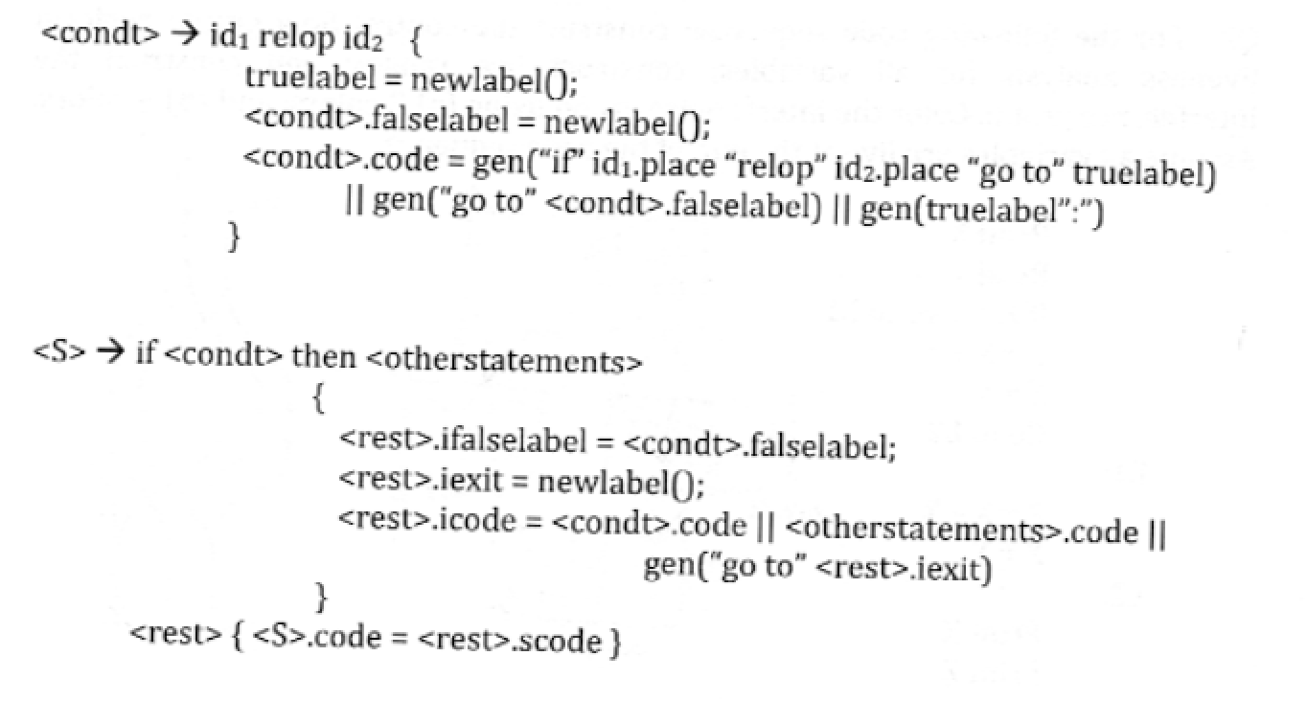

Slide 17
